Slide 1

Employee Retention Using Machine Learning and Data Science
Batch No. 13 :
17311A1295 – Vamshi Kiran. K
17311A12A0 – Joshua Sunder Raj.G
17311A12A7 – Abhinay. L
Guide – Ms. N. Divya

Slide 2

MODEL
COMPARISION
Preventive
Measures
Potential Benefits
Solution Process
Key Findings
Recommendation
Problem Overview
AGENDA

Slide 3
Problem : Employee Promotion Status
This Project Explains about the metrics which might be necessary for an employee to get promoted/not
Based on the Analysis, we can conclude that mostly the companies prefer to give promotion for the employee's based on their Previous_year_ratings, Avg_training_score, Age and etc, rather than just by seeing their Education Level, No_of_trainings or Awards_won the employee posses.
This Problem of most employee's not getting promoted can be prevented by using:
Using Advanced Technology in the workspace.
Better Training facilities.
Experienced Trainers.
Healthy and Friendly Environment.
Security

Slide 4




Solution Process
Model Validation
Model Performance measure on
testing data
Source of the Dataset:
Kaggle Data repository
The dataset consists of 54808 Observations with 13 Features including Target variable.
STEP
04
Model Preparation
We teach the model
on Training dataset,
STEP
03
Analytical approach
Supervised Machine Learning problem,
Two class Classification,
STEP
02
Analyse Data
Heterogeneous population, Anomaly Treatment, Missing Values Treatment, creating new variable
STEP
01

Slide 5
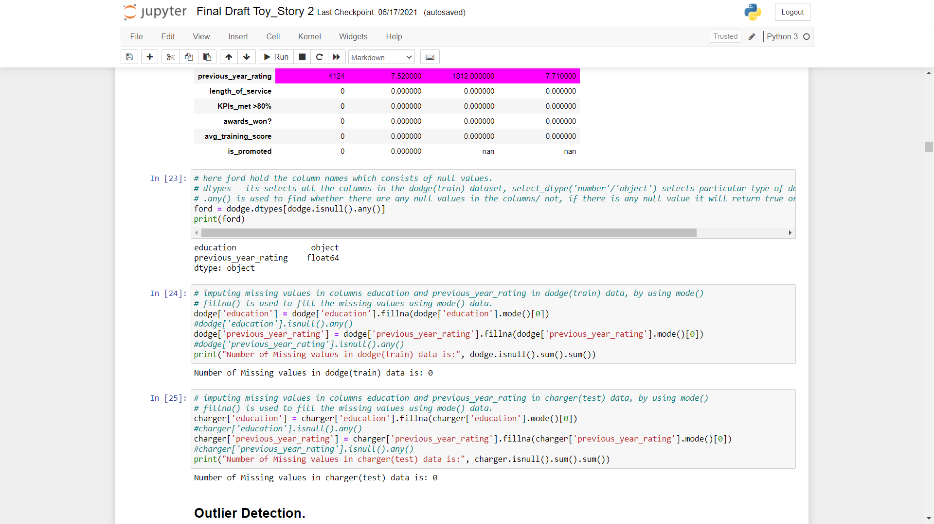
Treating Missing Values:
* Treatment of Missing Values is very Important Step in any Machine Learning Model Creation
* Missing Values can occur due to various reasons, such as the filling incomplete forms, values not available, etc

Slide 6
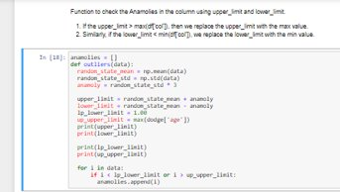
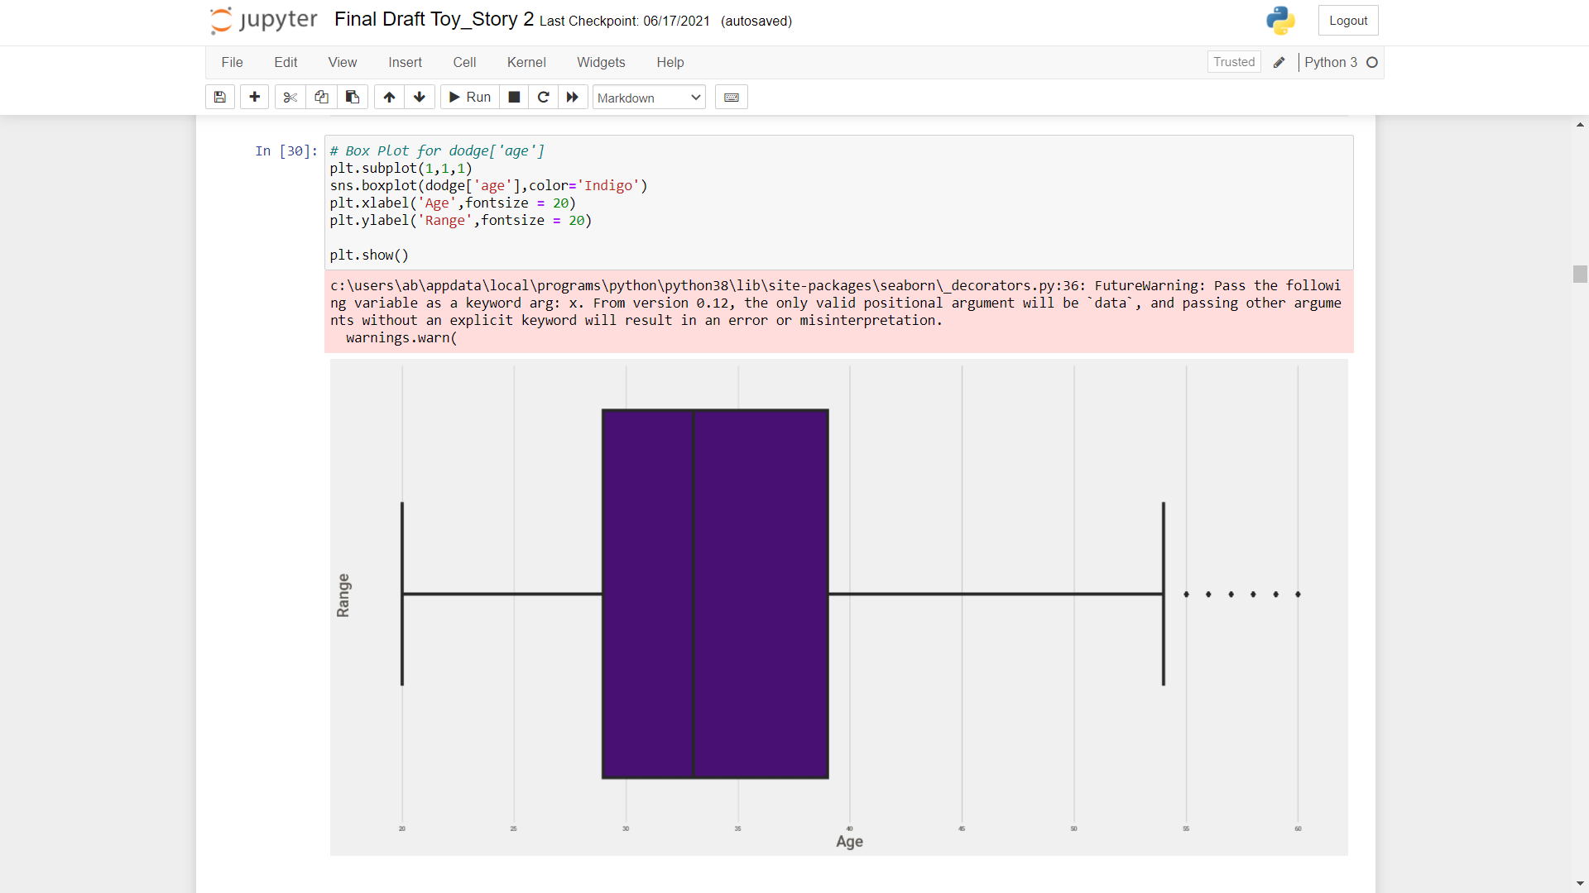
Outliers Detection:
Outliers in the dataset are referred as the huge difference between the range of values present in the dataset.
Now, this outliers can result in the poor performance of our predictive model and can result in incorrect results.
there are several methods in order to solve these outliers issues.
* Visualization.
* Standard Deviation
* Interquantile range

Slide 7
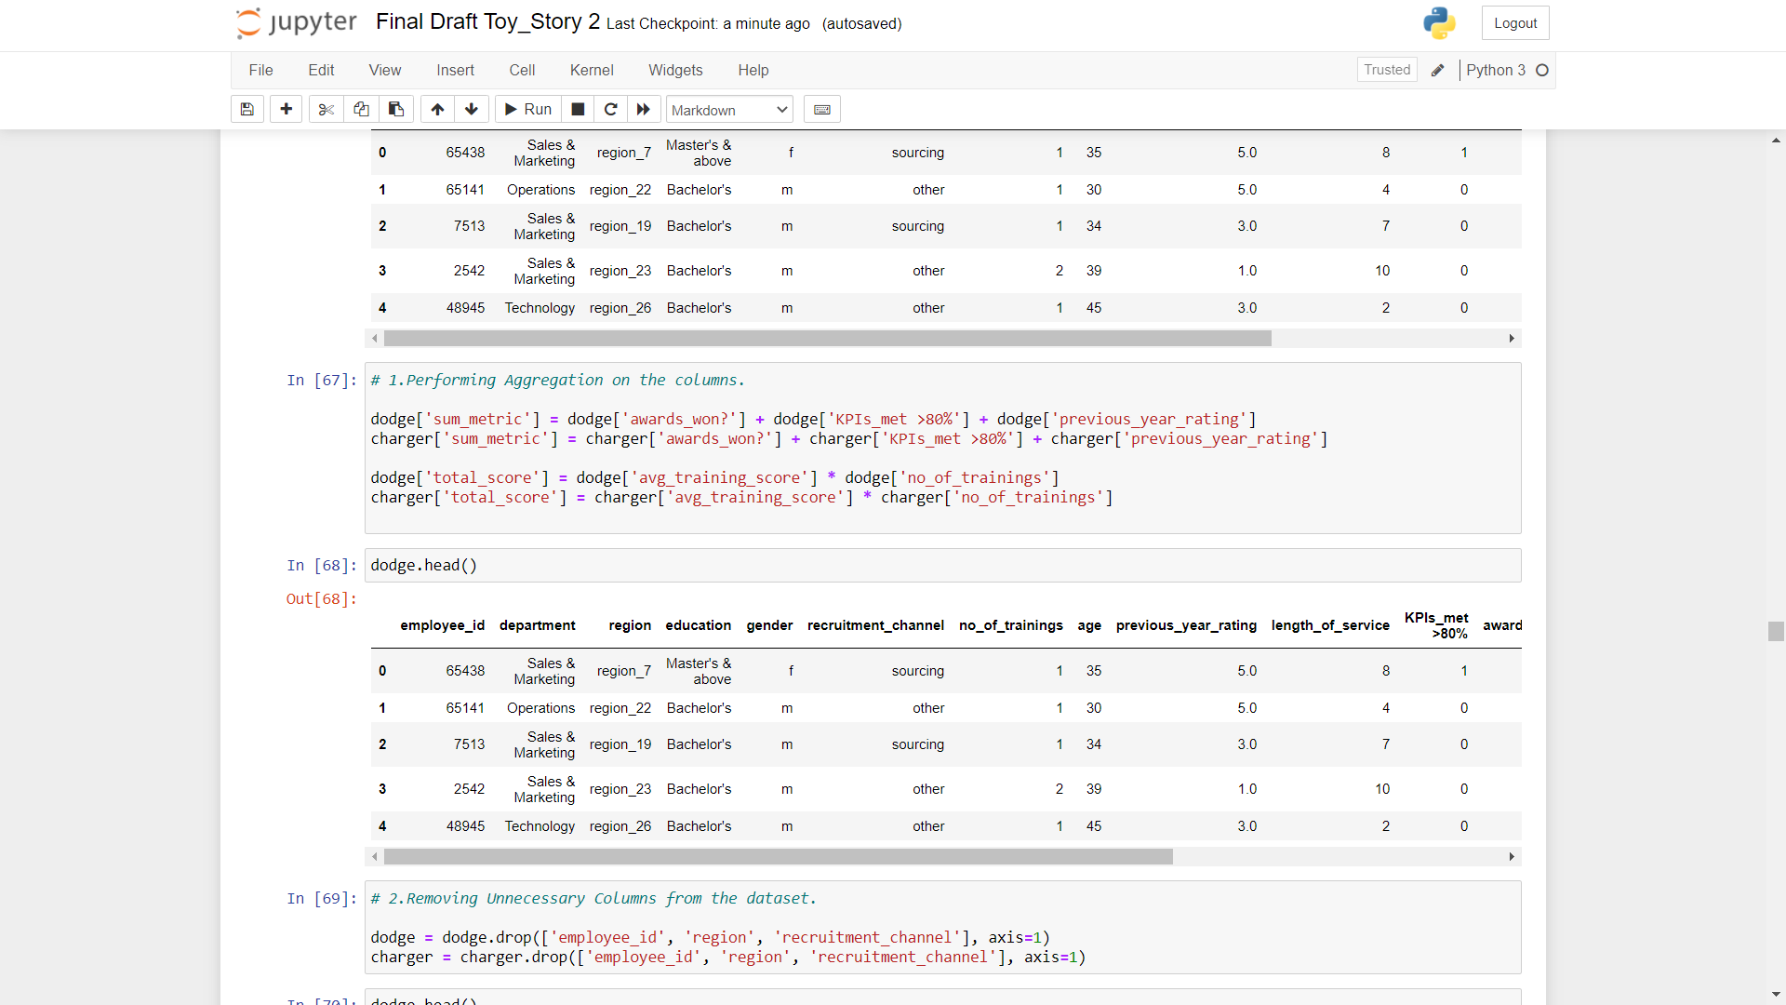
Feature Engineering:
* Feature Engineering is the Technique of using Domain Knowledge in order to extract the important features from the dataset using some data mining techniques.
* These features can in turn help us to create / build an efficient Machine Learning Model.

Slide 8
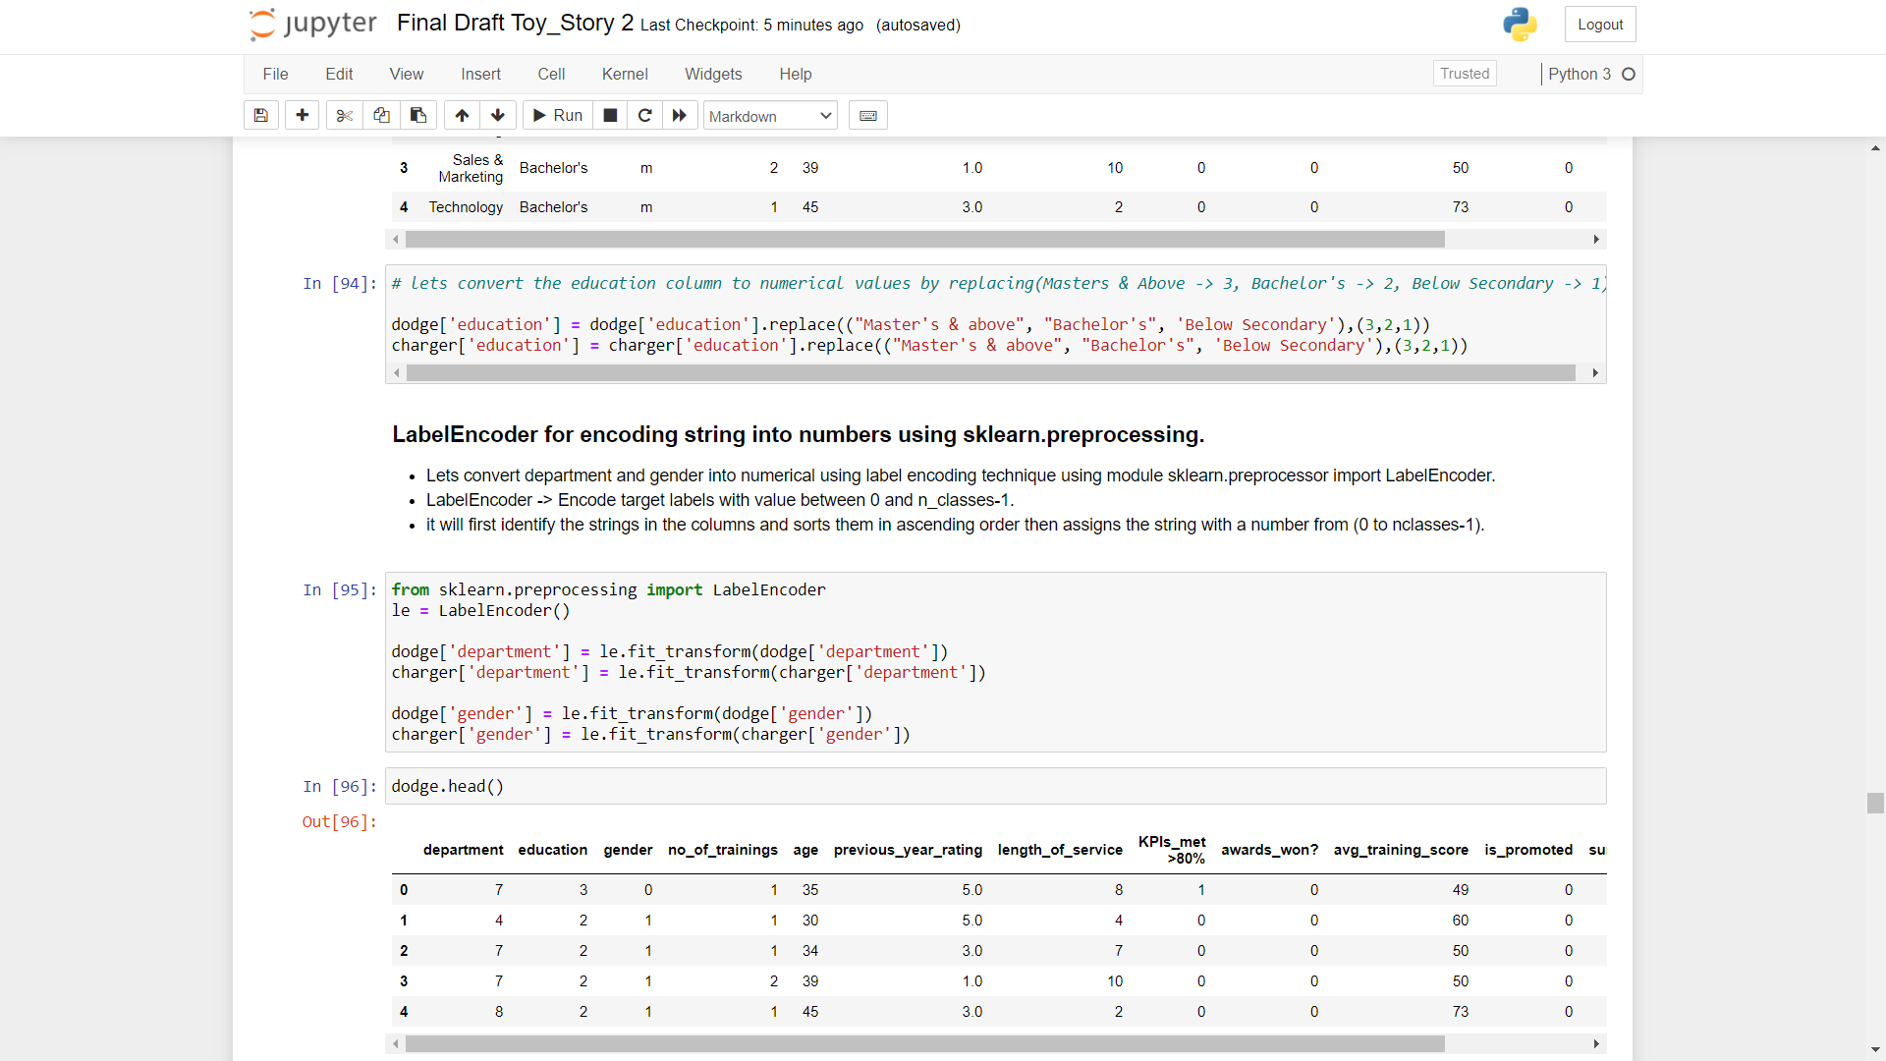
Feature Transformation:
* Dealing with categorical columns is a big step in a project, as sometimes they might hold the important values which help our model to predict accurately.
* Changing our categorical columns into numerical type is a very important step as most of the machine learning models works using numerical values compared to categorical/object type.

Slide 9
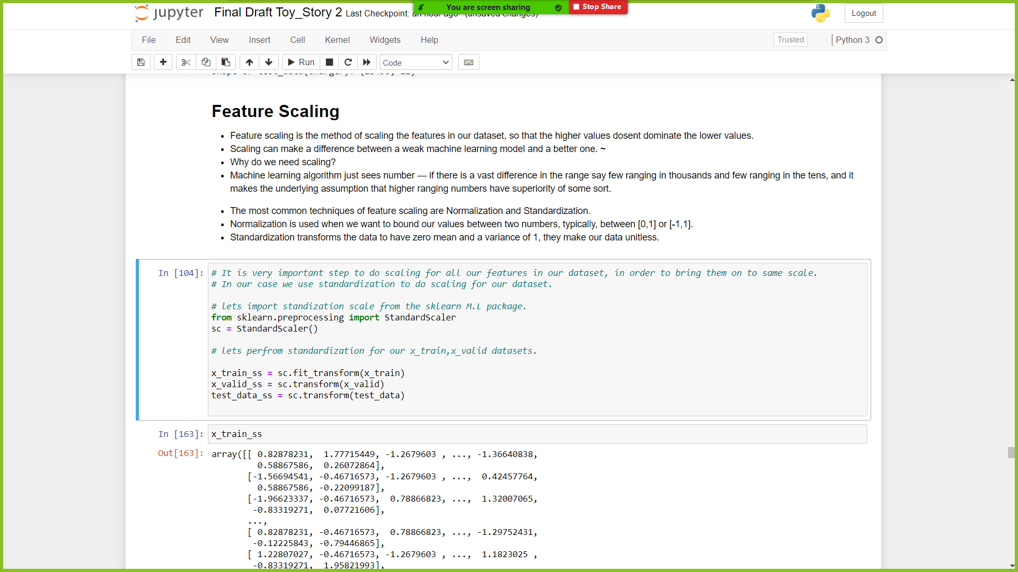
Feature Scaling:
* Feature scaling is the method of scaling the features in our dataset, so that the higher values dosent dominate the lower values.
* Scaling can make a difference between a weak machine learning model and a better one.

Slide 10
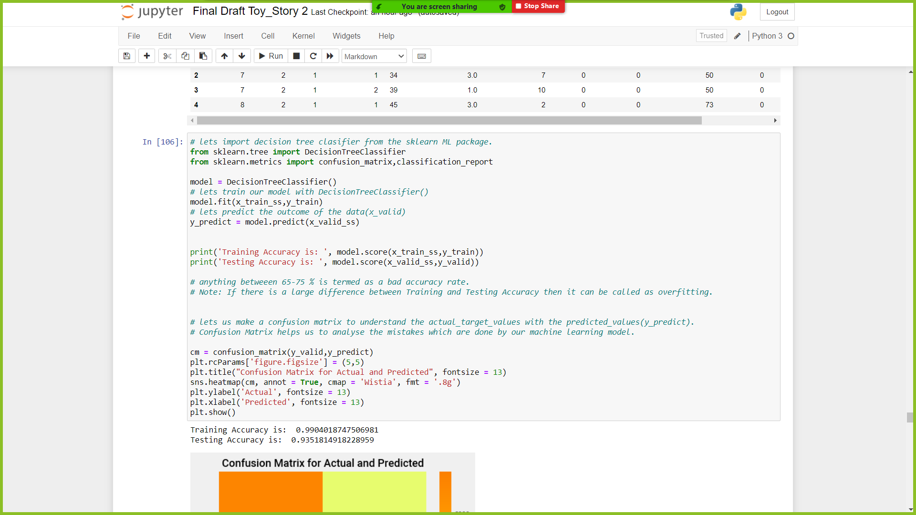
Predictive Models:
Decision Tree:
* A decision tree is a flowchart-like tree structure where an internal node represents feature(or attribute), the branch represents a decision rule, and each leaf node represents the outcome.
* The basic idea behind any decision tree algorithm is as follows:
* Make that attribute a decision node and breaks the dataset into smaller subsets.
* Starts tree building by repeating this process recursively for each child until one of the condition will match:

Slide 11
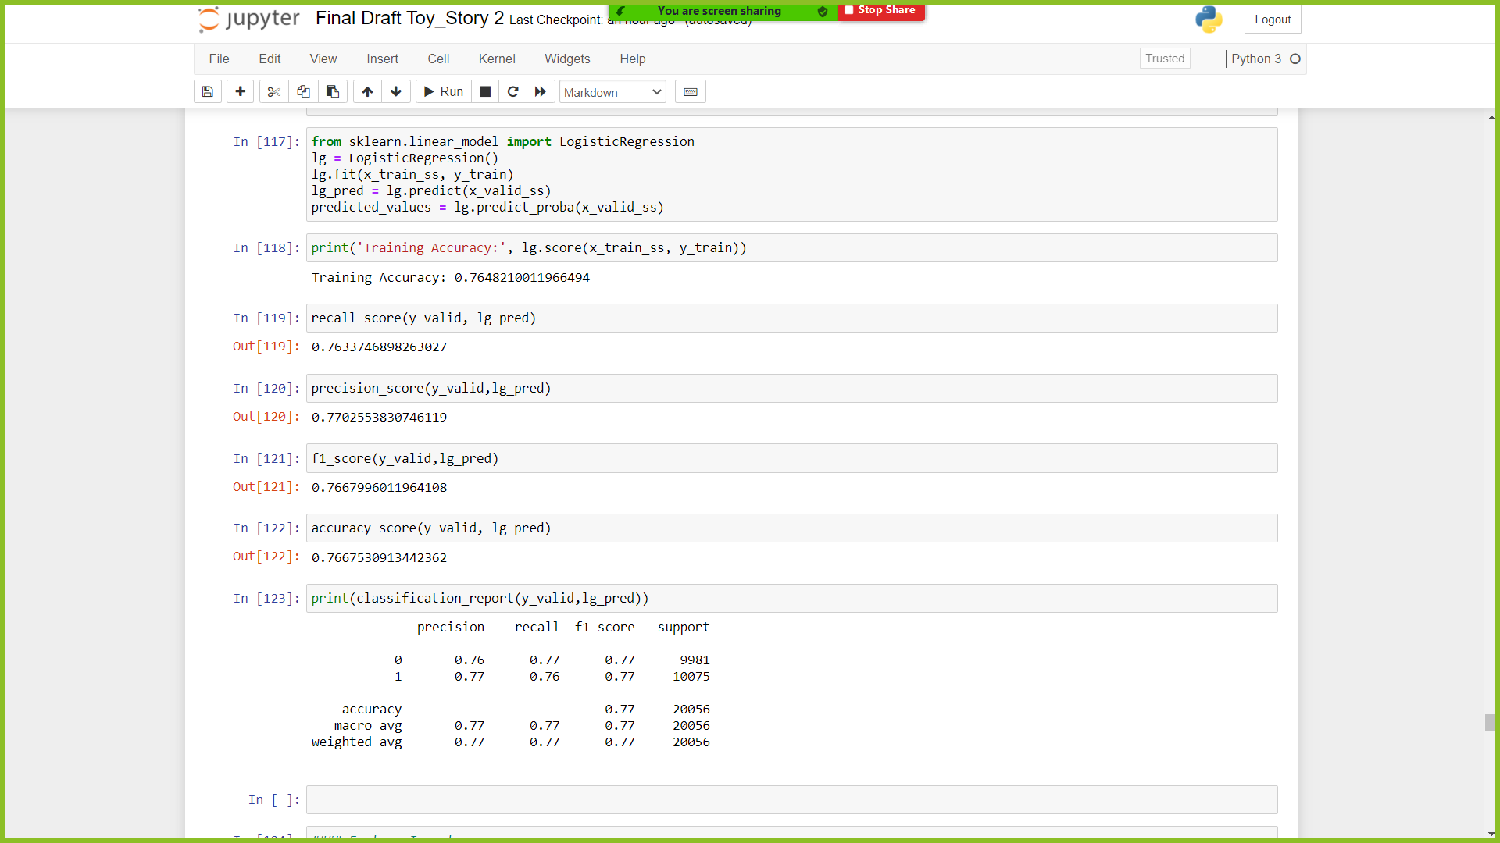
Logistic Regression:
In statistics, the logistic model (or logit model) is used to model the probability of a certain class or event existing such as pass/fail, win/lose, alive/dead or healthy/sick.

Slide 12
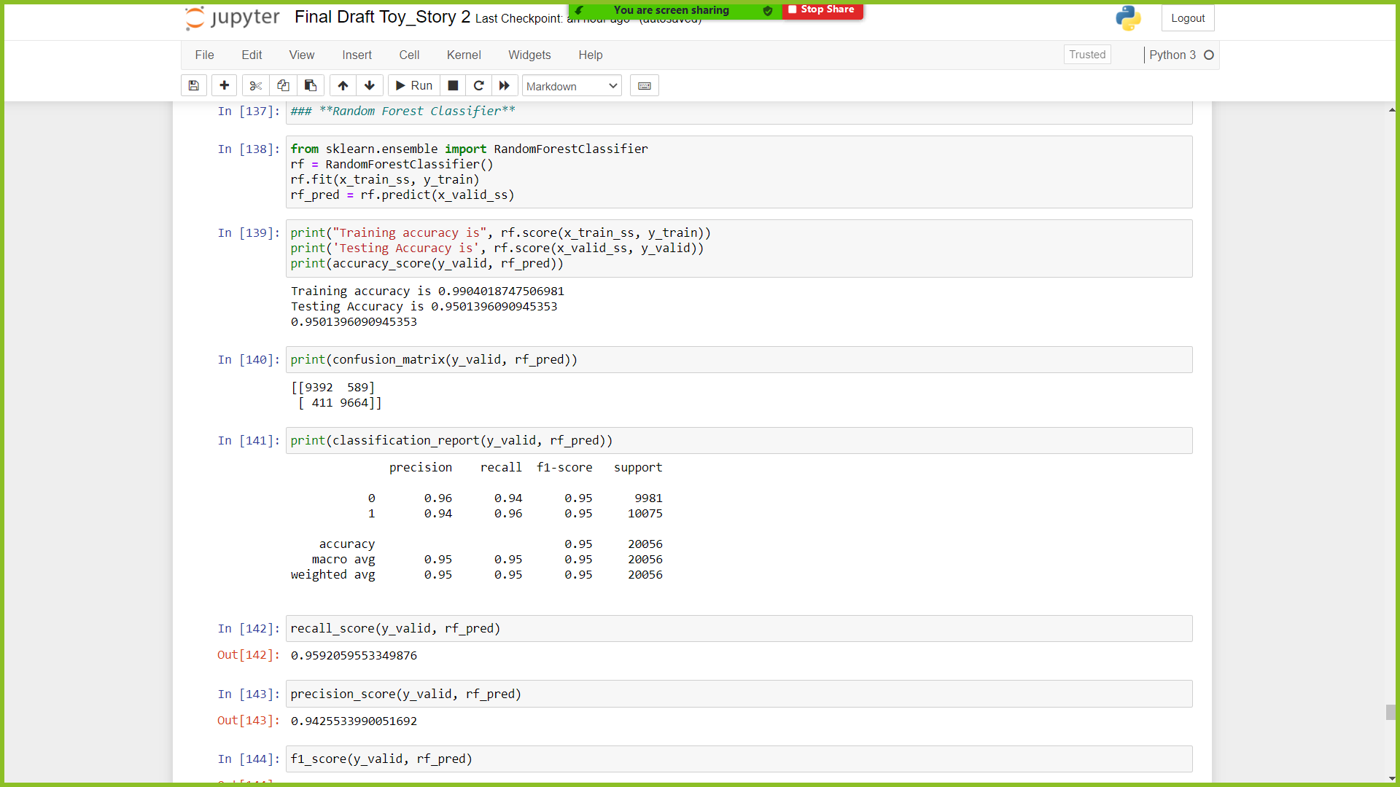
RandomForestClassifier:
Random Forest model is an ensemble algorithm, decision tree is used as a base model.
This also performs bootstraping on variable features along with the data points.

Slide 13
MODELS COMPARISION
MODEL 1
(Decision Tree)
MODEL 2
(Logistic Regression)
MODEL 3
(Random Forest)
Training | Testing
99% | 94%
100% | 94%
100% | 94%
100% | 94%
Training | Testing
76% | 75%
100% | 76%
100% | 75%
100% | 75%
Training | Testing
99% | 94%
100% | 94%
100% | 95%
100% | 95%
Accuracy_score
Precision_score
Recall_score
f1_score

Slide 14








Key Insights
The Most Important features that Influence the Problem.
Kpi's Met > 80%
Sum_Metric
Length
Of
Service
Rating's
Average
Training
Score
Department
Age
Total
Score

Slide 15
Showing No Discrimination and Partiality towards Employee's.
Better Security and Friendly Environment.
Spreading Positivity Around the
Organisation.
Experienced
Trainers to Train Employees.
Use of Advanced Technology.
Preventing Measures

Slide 16




Recommendation
Performance Based Rewards.
Organising monthly meets/Fun and Games and giving away paid holidays for the work they have done.
Providing Better Healthcare Benefits..
Healthcare funds should be must for an employee who works in the organisation day and night for the good of the company.
Balanced Work Load.
Balancing the workload for the employee's so that they might not face Mental Illnesses.
Balanced Work hours.
Balancing the work hours in the office or in home, so that employee's can spend some free time with their loved ones.

Slide 17
Conclusion:
This project entitled “Employee Retention Using Machine Learning and Data Science.”, is useful to identify the employees suitable for promotion.
The project is very useful to the Human Resources Department, in accurately determining the employees to be promoted.
The project is also useful to the hard-working employees, as their efforts are properly recognized by the tool, while determining the promotions.
This project finally leads to the quality of the working environment in organizations.
Future Work:
Although data sampling is an efficient way to augment the data, it may still be non representative of real-world.
Further studies are necessary to determine if the conclusion holds.
It is also recommended to extend this research to include more baseline models with a focus on feature engineering, i.e. using different data encoding and scaling methods.

Slide 18


Query?

